Slide 1
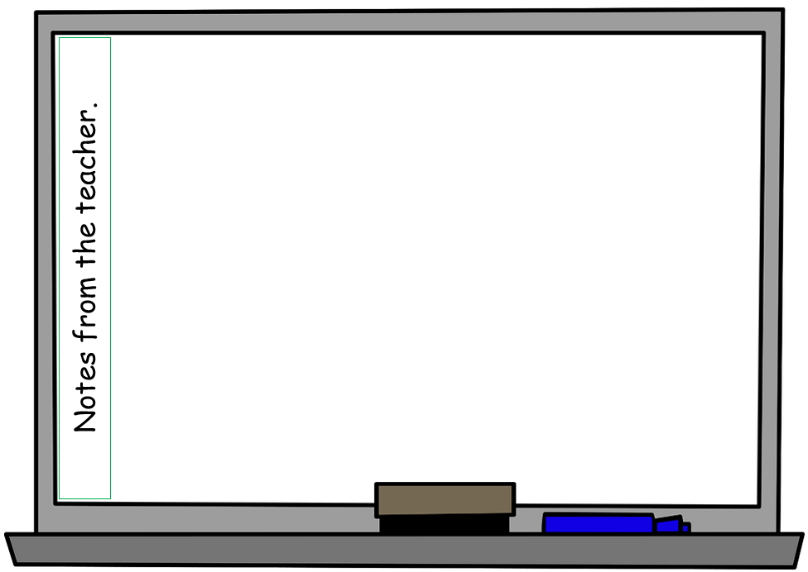
Type class/teacher details here
Today is:
2024
20/02/2024
7 Days
12Months
*Type here for any class notices.
Other notes (delete once you start using with the class):
- This page: simply drag days, months, dates, to the top of the page. Drag back when done. For the short date (18/2/2024), you type in the above box. For Teacher Notes, type in the box (this box).
- Page 2: simply drag the arrows to where you want them.
- Page 3: New: Move the arrows or star to the relevant words. For the school values, you will need to insert your own to replace the ones show.
Page 4: Type in below the sections of things the kids can do. Some examples are shown.

Slide 2
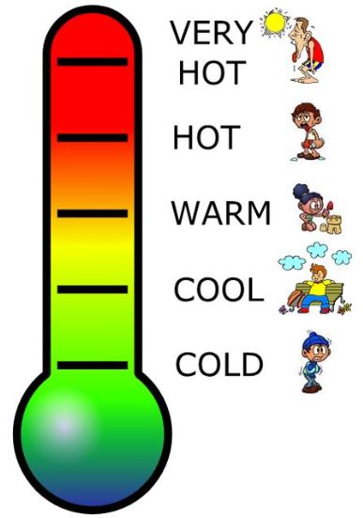
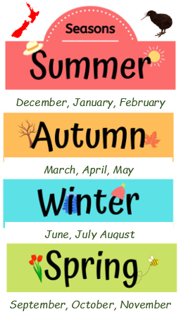
Type class/teacher details here
What’s the weather like today?

Slide 3
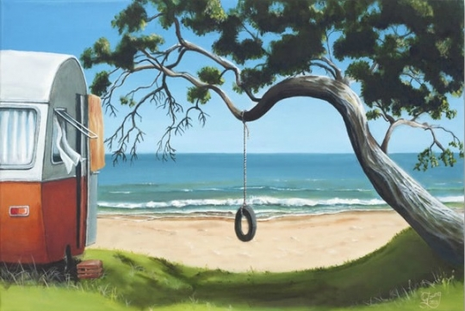
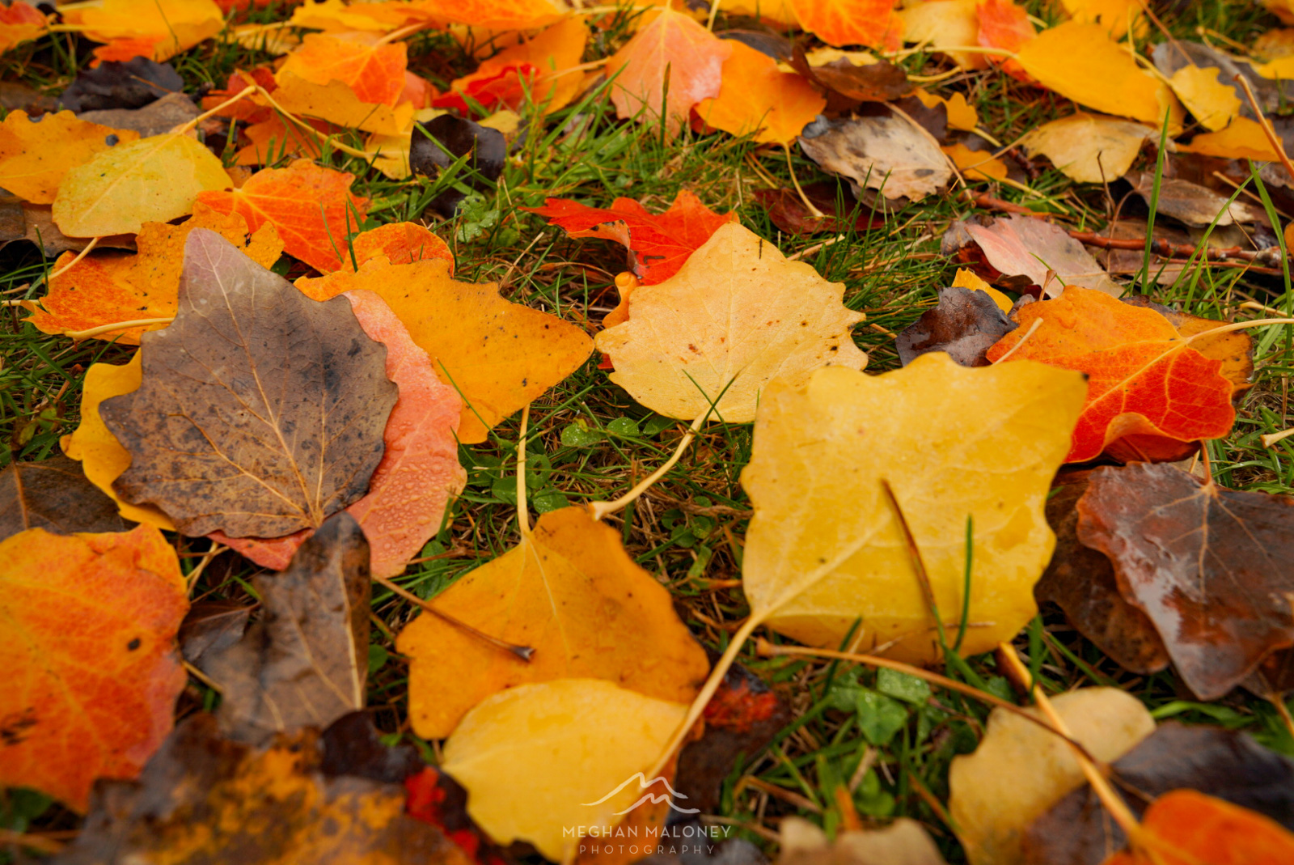
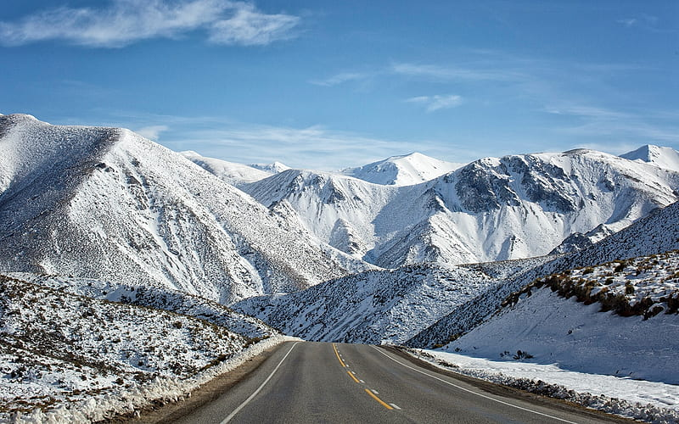
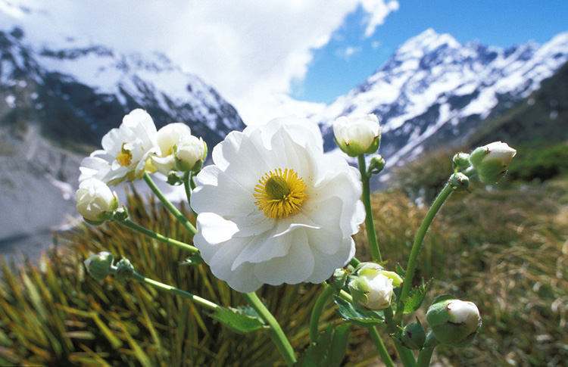

Slide 4
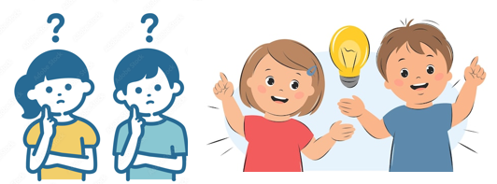
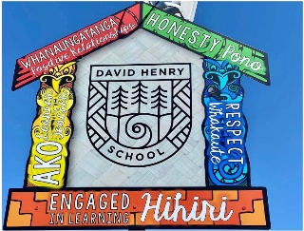
Self Directed Independent Options
Below are some of the options you can do when you have finsihed your work, or when you are stuck and I am busy with a group.
Maths Time | Word Study / Handwriting Time | Reading Time | Writing Time
1. Extra worksheet (if I have left one on the mat). 2. Practice writing some maths or numbers on a small whiteboard. 3. Class maths activity. 4. Draw or use your sketch pad. 5. Colouring. 6. Read a book. 7. Cut Out activity. 8. Ipads - (Maths apps only and no volume). | 1. Extra worksheet (if I have left one on the mat). 2. Practice writing your letters or words on a small whiteboard. 3. Class word or letter activity or flash cards. 4. Drawing or use your sketch pad. 5. Colouring. 6. Read a book. 7. Cut Out activity. 8. Ipads - (Word Study apps only and no volume). | 1. Draw a picture about something to do with the book you are reading. 2. Drawing or use your sketch pad. 3. Colouring. 4. Read a book. 5. Cut Out activity 6 Ipads - (Math or Word Study apps only, and no volume). | 1. Practice letters or words on a small whiteboard. 2. Write/draw your own mini comic strip about what you are writing about. 3. Drawing or use your sketch pad. 4. Colouring. 5. Read a book. 6. Cut Out activity 7 Ipads - (Math or Word Study apps only, and no volume).

